Slide 1












X
L
Z
V
S
T
N
O
L
A
C
C
H
F
Z
G
D
Q
X
LANGUAGE MASHUP
K
J
I
O
A
L
B
A Study in Mixed Language Translation
Language Mashups: Decoding Mixed Language Texts
F
B
S
G
E
Q
D
I
L
M
H
U
X
C
L
B
Z
C
V

Slide 2
PROBLEM
STATEMENT
MOTIVATION
In multilingual societies, individuals often communicate using a combination of languages in a single sentence, a phenomenon known as code-switching. For instance, in India, people frequently use a mix of Hindi, Telugu, and English in casual conversations. Current translation tools, such as Google Translate, are designed to handle only single-language inputs, which leads to poor or inaccurate translations when presented with code-switched or mixed-language text.
This gap creates a barrier for understanding and translating mixed-language content in various domains, including social media, customer service, education, and daily communication. There is a need for an effective solution that can accurately detect and translate code-switched sentences into a specific target language (e.g., English), while preserving the context and meaning of the original message.
Develop a natural language processing (NLP) system capable of accurately translating mixed language text into a specific target language, considering the complexities of code-switching and language variation.
Existing translation systems are unable to accurately process and translate code-mixed sentences, such as those combining Hindi, Telugu ,other regional langauges and English, into a single target language, resulting in incomplete or incorrect translations and limiting effective communication in multilingual environments.

Slide 3
USAGE
Social Media and Informal Communication:
WhatsApp, Facebook, Twitter: People often use a mix of languages when communicating with friends and family. Translating mixed-language posts, messages, or comments into one specific language (e.g., English) can help non-native speakers understand the content more easily.
Influencers and content creators often post captions in mixed languages to connect with a broader audience. Translating these captions can help widen their reach.
Customer Support for Multilingual Regions:
Many companies provide customer support via chat services, and customers often communicate in mixed languages. For example, a customer might speak in a mix of Hindi and English or Telugu and English. Having a tool to translate these conversations accurately would improve customer service.
E-commerce Platforms:
On platforms like Amazon or Flipkart, users leave reviews in mixed languages. Translating these reviews accurately into a single language would allow more customers to understand product feedback, regardless of their language proficiency.
Education:
Language learning platforms could use this to help users who speak in code-mixed languages and assist them in learning grammar or vocabulary by converting the mixed sentence into one language.
It could also be useful for teachers or institutions that handle students who communicate in a mix of languages in regions like India, where bilingual or trilingual usage is common.
Localization of Content:
Businesses that want to localize their websites, apps, or content for multilingual users could use such a tool to adapt their content for regions where code-switching (mixed-language use) is widespread.
Personal Assistance and Virtual Assistants:
Virtual assistants like Siri, Google Assistant, or Alexa can struggle with mixed-language commands. A translator that can handle mixed-language input would significantly improve user interactions with these assistants in multilingual regions.
Media and Entertainment:
Movies, TV shows, and web series often have dialogues in Hinglish or other language mixes. Subtitles or dubbing services could use this technology to create accurate translations for multilingual audiences.

Slide 4







PROPOSED PIPELINE
Data collection
Model selection
Evaluation and feedback
2
3
4
5
6
1
Final Deployment
Text preprocessing
Fine-tuning

Slide 5



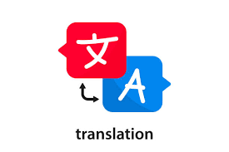


TIME LINES
WEEK1-2
WEEK3-4
Collect datasets with mixed-language texts from social media, bilingual forums, or user-generated content.
Clean and align mixed-language texts , and prepare for model training.
Fine-tune a pre-trained model using the mixed language dataset.
Experiment with different settings and hyperparameters to improve the translation of code-switched content.
WEEK5-6
WEEK7-8
Evaluate the model on mixed-language test sets using BLEU and TER scores.
Include human evaluation to ensure that the translation preserves meaning and maintains fluency.
Make final improvements to the model based on feedback and evaluation results.
Deploy the translation model via a interface or API for testing by users.

Slide 6

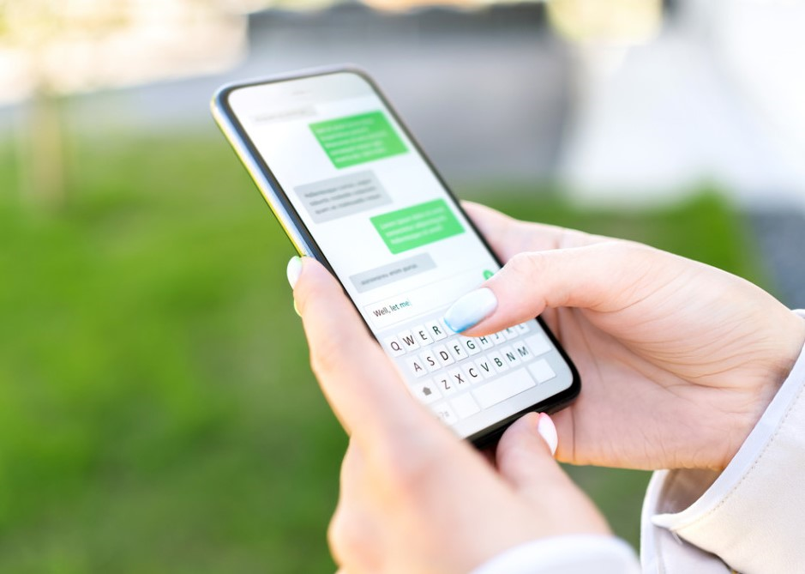
Project Goal and Expectations
The goal of this project is to enhance the understanding and translation of mixed-language inputs, specifically Telugu and Hindi typed in Roman script (English letters), into grammatically correct English, and vice versa. As mixed-language text is increasingly common on social media and other platforms, this project leverages NLP to build a system that recognizes, transliterates, and translates these texts accurately. The aim is to facilitate smooth communication between users from diverse linguistic backgrounds.
Expected Outcomes
Improved Language Understanding
Context-Aware Translation
Multilingual Social Media Support
Increased Accessibility

Slide 7


Findings & Research
Mixed Language
Translations by NLP
Mixed Language Translation with Natural Language Processing
• Addresses real-world communication challenges.
• Bridges digital divide for multilingual and low-resource communities.
• Improves human-computer interaction.
• Preserves indigenous and minority languages.
• Supports bilingual education.
• Enhances multilingual customer support.
• Facilitates cross-cultural communication.
• Contributes to commercial use in marketing and advertising.
• Enhances technology accessibility and inclusivity.
“What we Aim to Achieve”
Mixed Language Translation Aims
• Ensure seamless communication across languages, especially in multilingual regions.
• Facilitate accurate translation systems for code-switched conversations.
• Increase inclusivity and accessibility in technology for multilingual speakers.
• Support underrepresented and low-resource languages by promoting their preservation and digital relevance.
• Enhance multilingual education by developing tools for code-switched environments.
• Advance Natural Language Processing (NLP) research to handle multilingualism and complex linguistic phenomena.
• Improve human-computer interaction by creating conversational agents.
• Enhance business and commercial applications by serving multilingual markets.
• Enable real-time mixed language translation for code-switching conversations.

Slide 8
Applications:
“Real world Applications”
Quick Links of datasets
Telugu-Hindi Parallel Corpus
Description: A parallel corpus consisting of sentences in Telugu and their translations in Hindi, useful for training translation models.
Link: WWW.Telugu-Hindi Parallel Corpus.Com
Code-Switched Content in Social Media and Customer Care
• Natural language processing (NLP) tools enhance content moderation and targeted advertising.
• Chatbots and customer care systems with mixed language translation capabilities assist consumers with code-switched inquiries.
• Conversational AI and Virtual Assistants improve accessibility and user experience for multilingual speakers.
• Multilingual educational tools cater to students' linguistic needs and enhance learning results.
• Real-time translation services improve communication during international conferences or meetings.
• Code-switched formats aid in multicultural marketing campaigns.
Indic NLP Library
Description: Contains multilingual datasets, including Telugu to Hindi translations, as part of its language resources.
Link: Indic NLP Library GitHub
Hindi to English Datasets
Hindi-English Parallel Corpus
Description: A dataset providing parallel sentences in Hindi and English, ideal for training and evaluating machine translation models.
Link: www.Kaggle - Hindi-English Parallel Corpus.com
OpenSubtitles Hindi-English Dataset
Link: WWW.OpenSubtitles Hindi-English Dataset.Com
Tatoeba Project
Description: A collection of sentences and translations, including Hindi to English and English to Hindi translations.
Link: WWW.Tatoeba Hindi-English Dataset.Com

